Slide 1

STRATEGIC DIGITAL
MARKETING PLAYBOOK
GOOGLE ANALYTICS
Tracking & Analyzing Data in GA4

Slide 2
INSTRUCTIONS: GETTING STARTED
Complete your assignment on the following slides .
Set the share settings so anyone with the link can view the document.
Submit the link to this deck in the Learning Management System.
Tips for completing your assignment:
Rename your copy and add your name to the file.
Example: Playbook Assignment: Create a GoDaddy customer persona-MRogers.
Read each slide carefully to ensure you complete the assignment successfully.
Review your playbook before submitting for accuracy, grammar and spelling.
Watch this video for a quick demo
© 2025 Ziplines Education | Proprietary and Confidential | Do not duplicate or distribute without written permission.

Slide 3
INSTRUCTIONS: Introduction and assignment
Digital analytics is the practice of tracking and analyzing website or app data to measure progress toward business goals. Google Analytics 4 (GA4) provides insights that help guide marketing strategies, improve content, and identify audience opportunities.
This playbook will help you learn how to navigate GA4, locate key metrics, and gather insights.
Using the Google Analytics 4 Demo Account (Google Merch Store), you will complete the exercises on slides 9-12 to practice finding and interpreting data.
Important to note: These exercises will also prepare you for the Google Analytics Certification and build confidence using real analytics tools.
REVIEW
COMPLETE
REFLECT
SUBMIT
© 2025 Ziplines Education | Proprietary and Confidential | Do not duplicate or distribute without written permission.

Slide 4
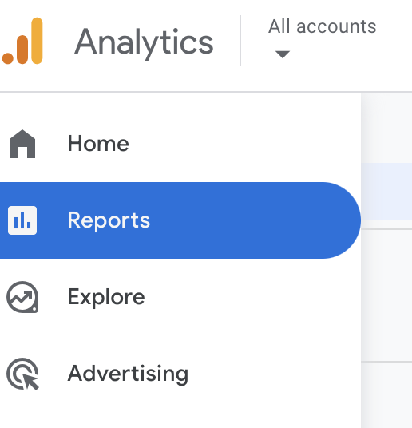
REVIEW: Google Analytics dashboard
Please log into your own free Google Account and then click on this link to access the Google Demo Account to use for this playbook, then select the Google Analytics 4 Google Merch Store link.
HOME - The default landing page provides a snapshot of key metrics and trends. Think of it as your GA4 dashboard.
REPORTS - Here you’ll find pre-built reports on various aspects of user behavior and website/app performance.
EXPLORE - Free-form exploration by creating ad-hoc, customizable reports with drag and drop tools for advanced techniques with deeper dimensions and metrics.
ADVERTISING - Understand how different marketing channels contribute to conversions and find your top attribution channels.
© 2025 Ziplines Education | Proprietary and Confidential | Do not duplicate or distribute without written permission.

Slide 5
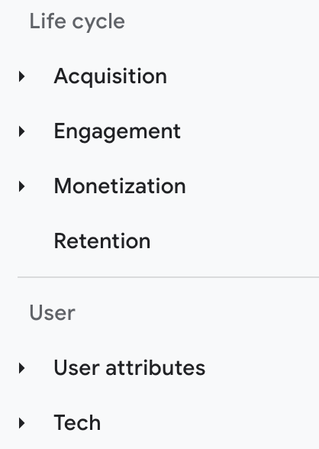
REVIEW: Categories for data
Drilling deeper into those sections, you’ll find the following categories for data:
Acquisition - How did we acquire the users? How did users find and arrive at our website or app?
Engagement - What actions did users take, and how did they interact with our content?
Monetization - Did users generate revenue, and how much value did they bring through purchases or other conversions?
Retention - How often do users return to our website or app over time?
User attributes - Who are our users, and what are their demographic characteristics and interests?
Tech - What devices, browsers, and technology are our users utilizing to access our content?
© 2025 Ziplines Education | Proprietary and Confidential | Do not duplicate or distribute without written permission.

Slide 6
REVIEW: Google Analytics analysis terms & tools
Option | Usage
Filters | Basic reporting: Quickly refine data within a specific report based on predefined criteria.
Dimensions | Basic reporting: Choose how data is presented and analyzed by selecting different attributes.
Secondary dimensions: | Advanced reporting: Add another layer of analysis to your reports.
Segments | Advanced reporting: Create custom groupings of users or events for more in-depth analysis across multiple reports.
Comparison | Compare different user segments side-by-side to identify patterns, trends, and areas for improvement.
Data Stream | Lives within a property and is a source of data from your app or website.
© 2025 Ziplines Education | Proprietary and Confidential | Do not duplicate or distribute without written permission.

Slide 7
COMPLETE: Let’s find data for acquisition
Time to deep dive into channels and sources to find out how you acquired your users. Reference the Google Analytics 4 (GA4) Demo Account for completing this assignment. For each of the questions below, your goal is to name the report and the final steps you would take to locate the data.
QUESTION | RESPONSE
What report would you access and what are the last two steps you would take to find the traffic channel that acquired the most users? | Report: Life Cycle Last steps: I would go to ‘Aquisition” and then click “User Aquisition” Scroll down to the chart and see the channel with the most “total users”
What report would you access and what are the last two steps you would take to find out how much traffic comes from referrals? | Report: Life Cycle Last steps: Click “Life Cycle” then “Traffic Aquisition” Look at the “referral” section on the chart.
Within the same report above, what are the last three steps you would take to compare how traffic sources changed between two months? | Last steps: Select “Month” on the drop down and compare the data from July to August.
© 2025 Ziplines Education | Proprietary and Confidential | Do not duplicate or distribute without written permission.

Slide 8
COMPLETE: Let’s find data for engagement
Next up, explore how to locate data in GA4 that reflects user behavior — such as top content, and key engagement trends. For each of the questions below, your goal is to name the report and the final steps you would take to locate the data.
QUESTION | RESPONSE
What report would you access and what are the last two steps you would take to find which pages are viewed the most? | Report: Engagement - Overview Last steps: Go to “engagemet”, then “engagement overview”, scroll down to “Views by Page title and screen class” and see which page is at the top of the chart for views
Within the same report as above, what are the last three steps you would take to check the average engagement time for mobile users on the home page? | Last steps: Go to “engagemet”, then “engagement overview”, view the “Average online active user engagement time”
What report would you access and what final step would you take to identify the event with the highest number of occurrences in a given time frame? | Report: Engagement - Events Final step: Go to “engagemet”, then click “events.” Scroll down to the “event count” section on the chart and see the event name that is at the top of the chart.
© 2025 Ziplines Education | Proprietary and Confidential | Do not duplicate or distribute without written permission.

Slide 9
COMPLETE: Let’s find data for monetization
If applicable, you can use the monetization reports in GA4 to explore where you can find insights about transactions, revenue, and product performance. For each of the questions below, your goal is to name the report you would access and identify the section you would view on that report to locate the data.
QUESTION | RESPONSE
What report would you access and what section would you view on the report to find the total revenue generated from ecommerce purchases? | Report: Monetization - Ecommerce Purchases Section: Item Revenue
Within the same report as above, what section would you view on the report to find how many users made a purchase? | Section: Purchase Journey - 5. Purchase (User Count)
Continuing in the same report, what section would you view on the report to find the average revenue generated per purchasing user? | Section: Monetization - Overview - Average purchase revenue per active user
© 2025 Ziplines Education | Proprietary and Confidential | Do not duplicate or distribute without written permission.

Slide 10
COMPLETE: Let’s find data for demographics
Now it's time to learn about users: age, gender, interests, devices, etc. These insights can help you understand who your users are and how to segment them effectively. For each of the questions below, your goal is to name the report you would access and the section you would view on that report to locate the data.
QUESTION | RESPONSE
What report would you access and what section of the report would you view to find the percentage of users who are female? | Report: User Section: User Attributes - Overview - Active users by gender
Within the same report as above, what section would you view to find the top interests of users who use the website? | Section: Active Users by interest
Continuing in the same report, what section would you view to find the country with the highest number of users? | Section: Active Users by country
© 2025 Ziplines Education | Proprietary and Confidential | Do not duplicate or distribute without written permission.

Slide 11
OPTIONAL: GA4 certification prep
Get ready for the GA4 certification, with these realistic insight-focuses practice questions. You got this!
QUESTION | RESPONSE
When you view a User Acquisition Report and a Traffic Acquisition Report, what are the key differences in the information each report will highlight for you? | User Acquisition: Delete this text and add your answer here. Traffic Acquisition: Delete this text and add your answer here.
To understand how many users are coming from various devices, like desktops or mobile phones, you run a report that shows this data, per device, over the past 30 days. In this report, what is device type? | Delete this text and add your answer here.
You want to create new audiences for your eCommerce site by segmenting users according to parameters that make sense for your business, like those who've made a purchase. Which approach would provide you with a predictive audience? | Delete this text and add your answer here.
When Google Analytics and Google Ads are linked, how can Google Ads use conversion events from Google Analytics? | Delete this text and add your answer here.
© 2025 Ziplines Education | Proprietary and Confidential | Do not duplicate or distribute without written permission.

Slide 12
COMPLETE: AI use in the playbook
Per the course AI guidelines you are required to indicate where and how AI tools were used in your assignments (e.g., idea generation, drafting, proofreading, etc.). Please complete the following:
QUESTION | ANSWER
Did you use AI when completing this assignment? | No, I did not.
If yes, explain how you used AI tools to assist you in completing the assignment. Include where you used it.
© 2025 Ziplines Education | Proprietary and Confidential | Do not duplicate or distribute without written permission.

Slide 13
INSTRUCTIONS: SUBMIT IT
Review each slide and make sure you have completed the entire assignment
Set share settings so anyone with the link can view the document
Access the correct assignment submission page in the Learning Management System
Copy/Paste the link to your assignment in the system by the due date
Confirm the assignment was accepted by the Learning Management System
How to set share settings:
Click “Share” in the upper right corner
Under “General Access”, select “anyone with the link”
Click “Copy” and then “Done”
Paste the link in the correct assignment submission page in the LMS
Watch this video for a quick demo

